Slide 1
Report for Community Council
25th October 2021 – 19th November 2021

Slide 2
Numbers
Number of Young People worked with - 339
Number of Activities - 49
Number of Learning Hours – 428

Slide 3
Spooktacular Halloween Session
On Wednesday 27th October we had our Annual Spooktacular Halloween Session
We played lots of Halloween themed games and Halloween Themed Musical Games
Huge thank you to Ethan for Carving out Pumpkin 🎃
Wanda for filling it with Lolly’s
Joan Urquhart and pupils from Fortrose Academy Learning Support department for making out Mummy Sausage Rolls Ethan for making all our delicious cakes 🎂

Slide 4
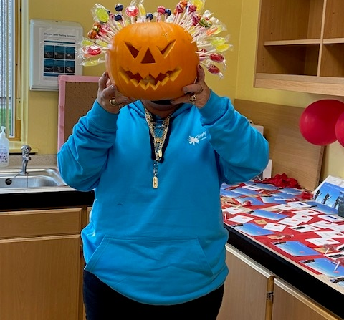
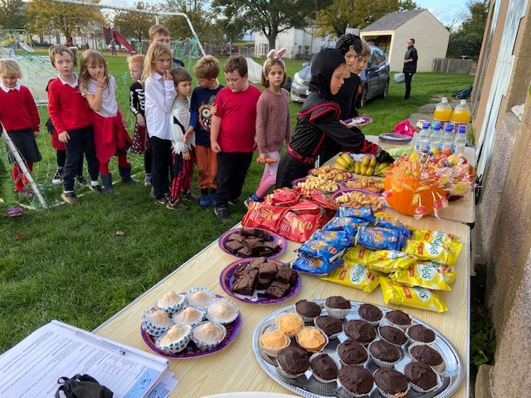

Slide 5
Football Coaching
Football Coaching with Inverness Caley Thistle Community Development Team
25 young people attending weekly sessions
Benefits of football training for Young People
Improves Cardiovascular Health
Builds Muscle Strength
Teaches Coordination
Promotes Teamwork and Sharing
Increases Cognitive Brain Function
Increase Confidence and Self-Esteem
Helps to Reduce Anxiety

Slide 6
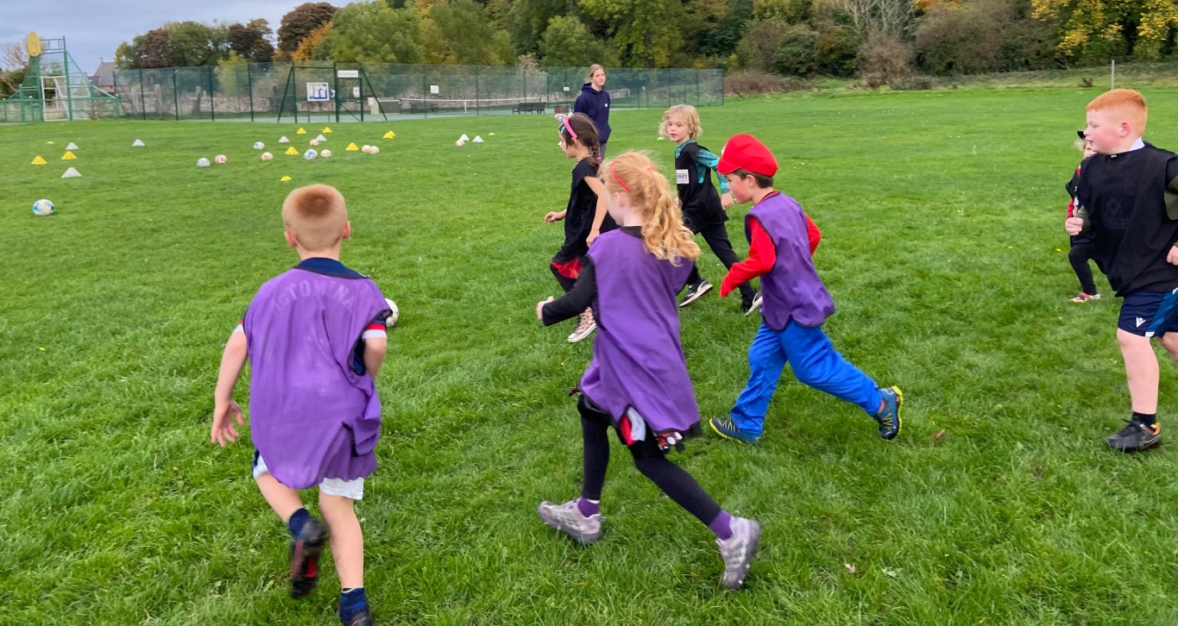
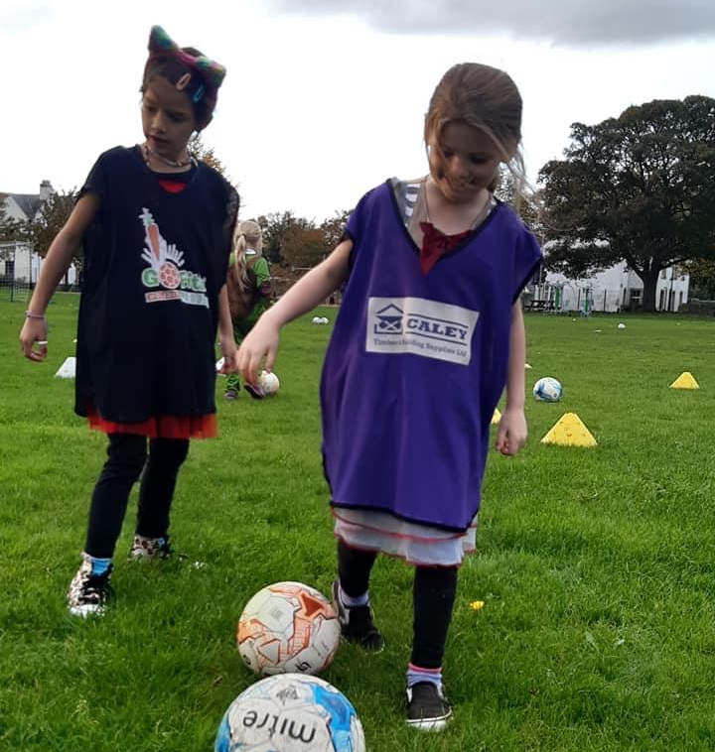
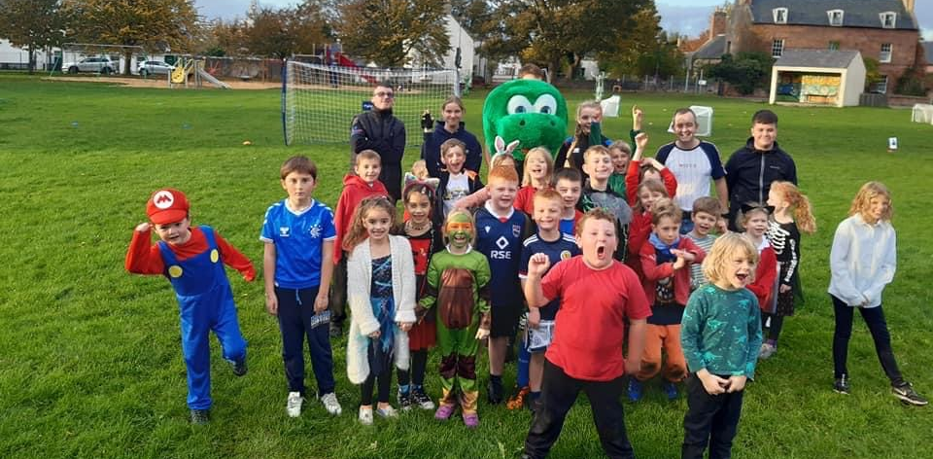

Slide 7
Jnr Youth Café
Over the last few weeks at Jnrs we have been focusing on Christmas crafts
Making Snowflakes and young people decorating them
Some of the snowflakes have been donated to a member of the community for their Christmas Display in Townlands Park.
All the young people have lots of fun at Youth Café - I know this because the YP tell us.

Slide 8
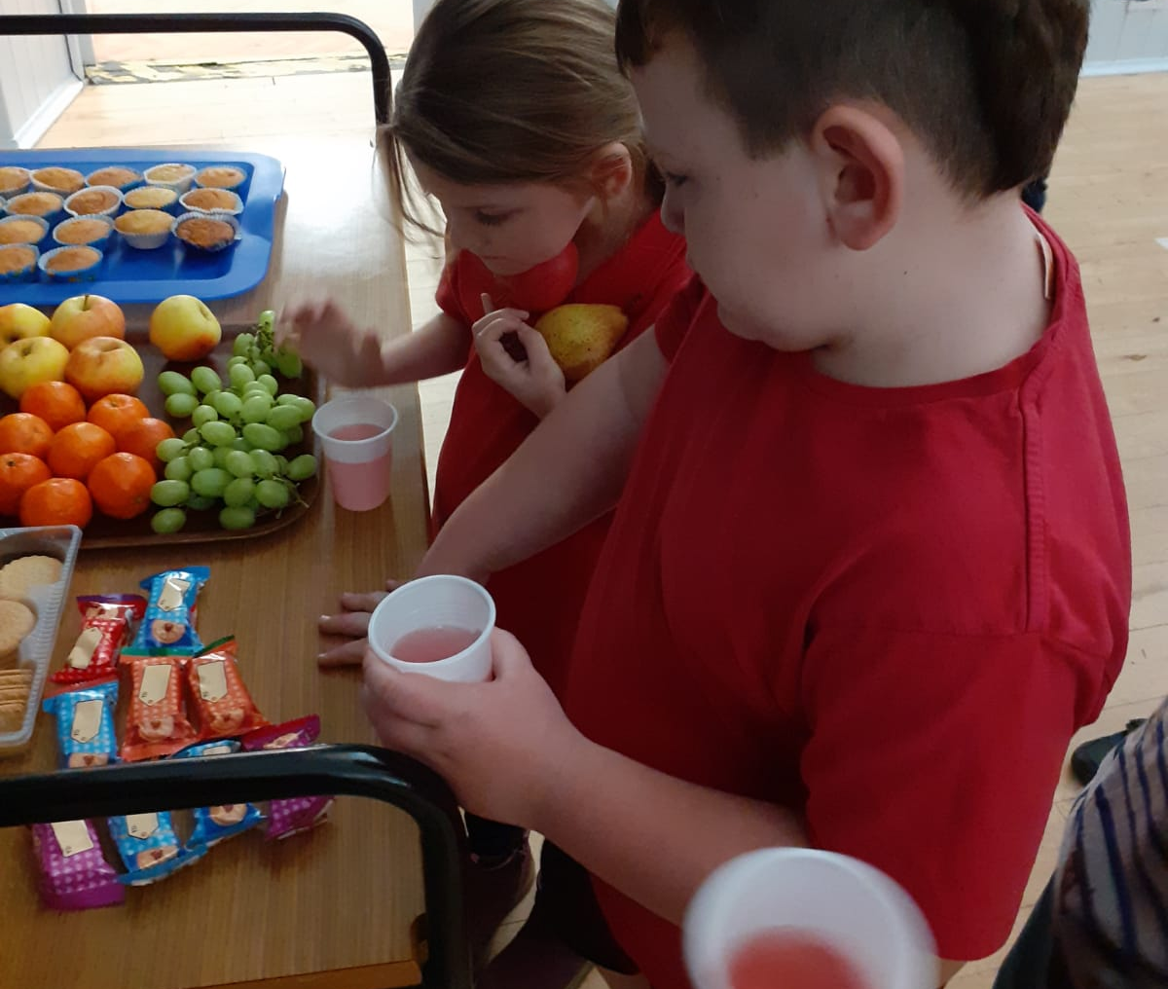
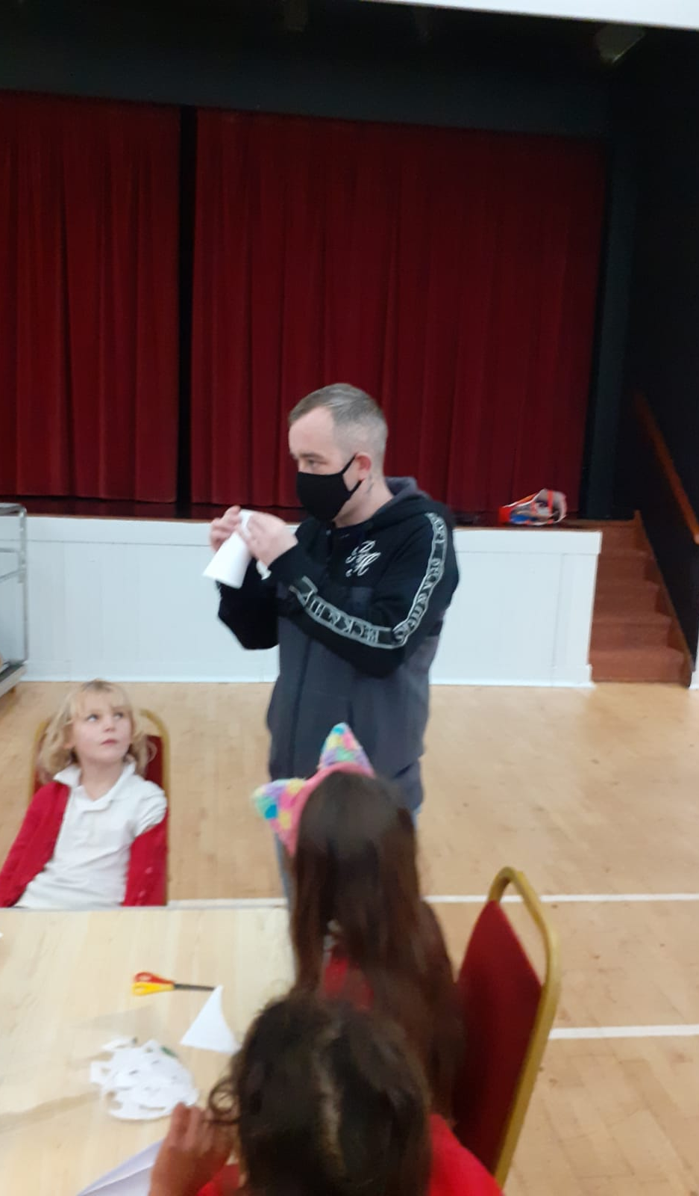
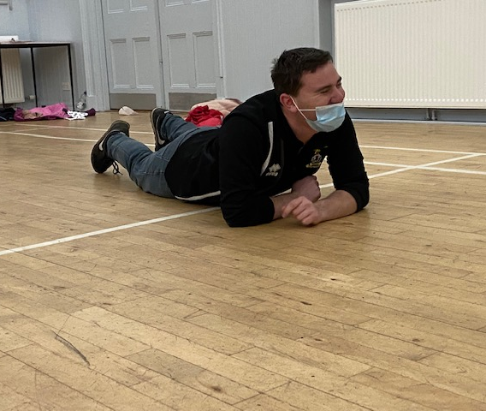
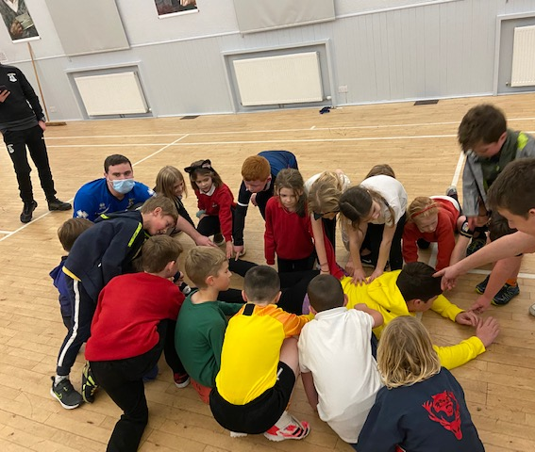
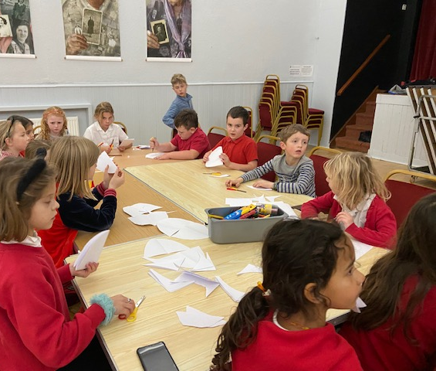

Slide 9
Badminton Classes
Weekly Class on a Wednesday night with 12 people attending
Learning techniques , skills and playing games
Skills are improving weekly.

Slide 10
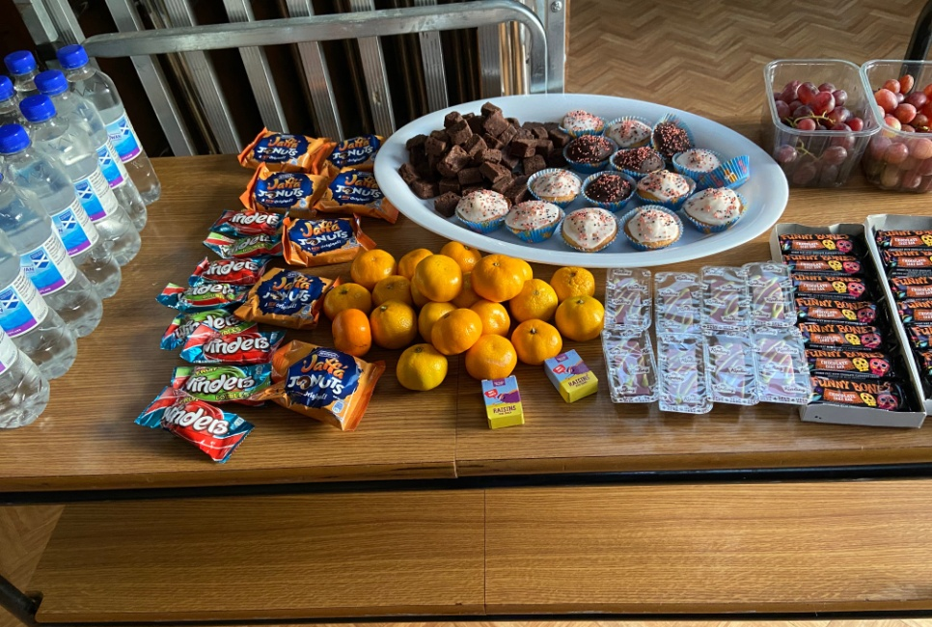
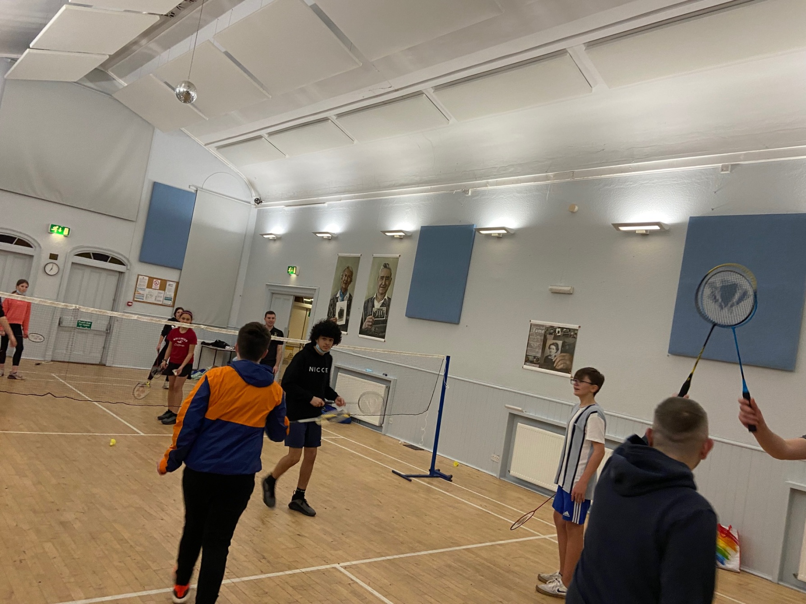
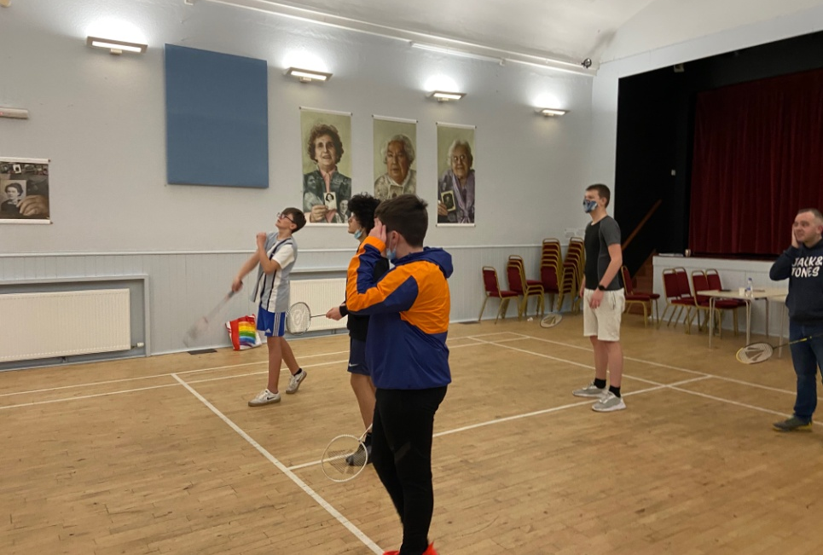

Slide 11
1-1’s & Emotional Check In’s
These emotional check in’s are really important to young people – for their well-being
Giving young people a safe space to talk to a trusted adult.

Slide 12
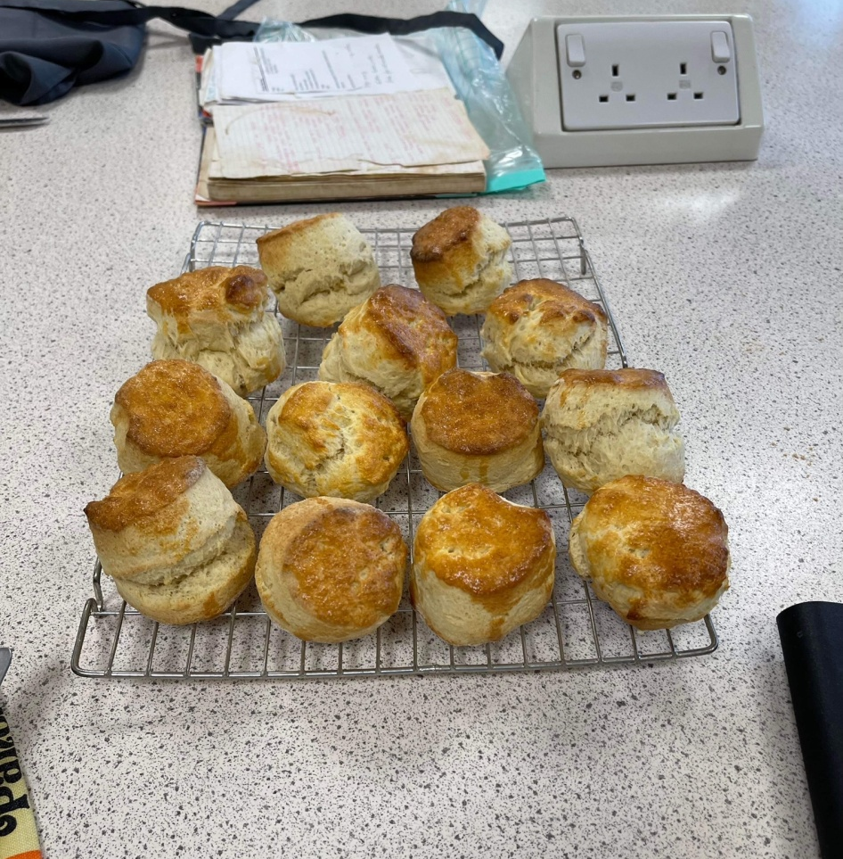
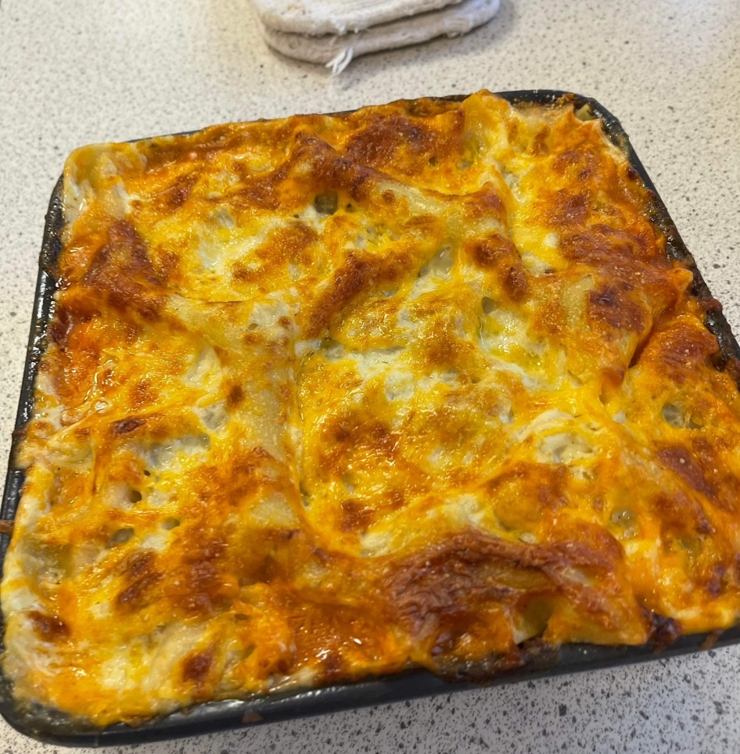
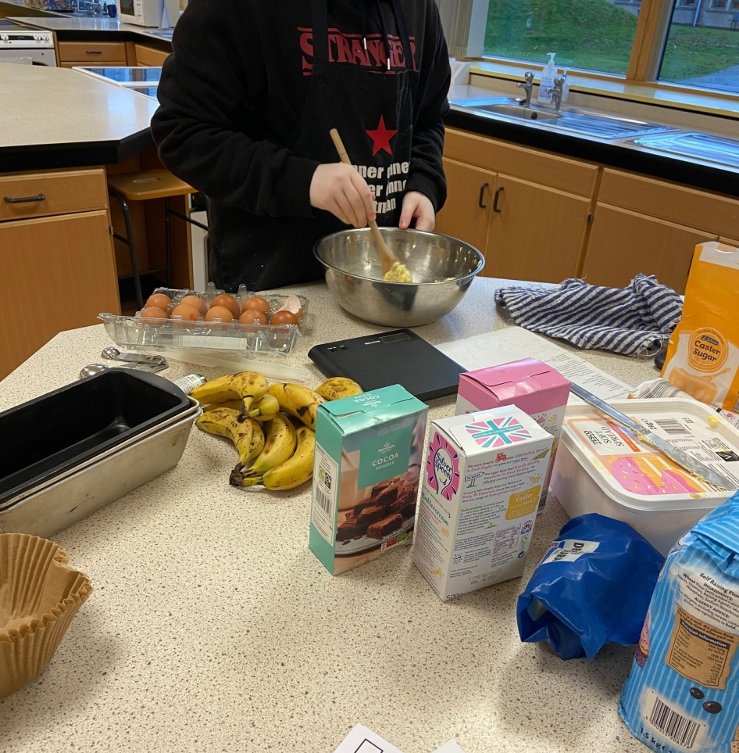
Cookwell / Bakewell
Weekly Baking & Cooking session with Cromarty young people
Trying new recipes
Lots of conversations about cooking and baking
Talking about being able to use substitute ingredients if needed
This has been great to be able to use The Youthwork Class kitchen to enable us to provide food at every activity.

Slide 13
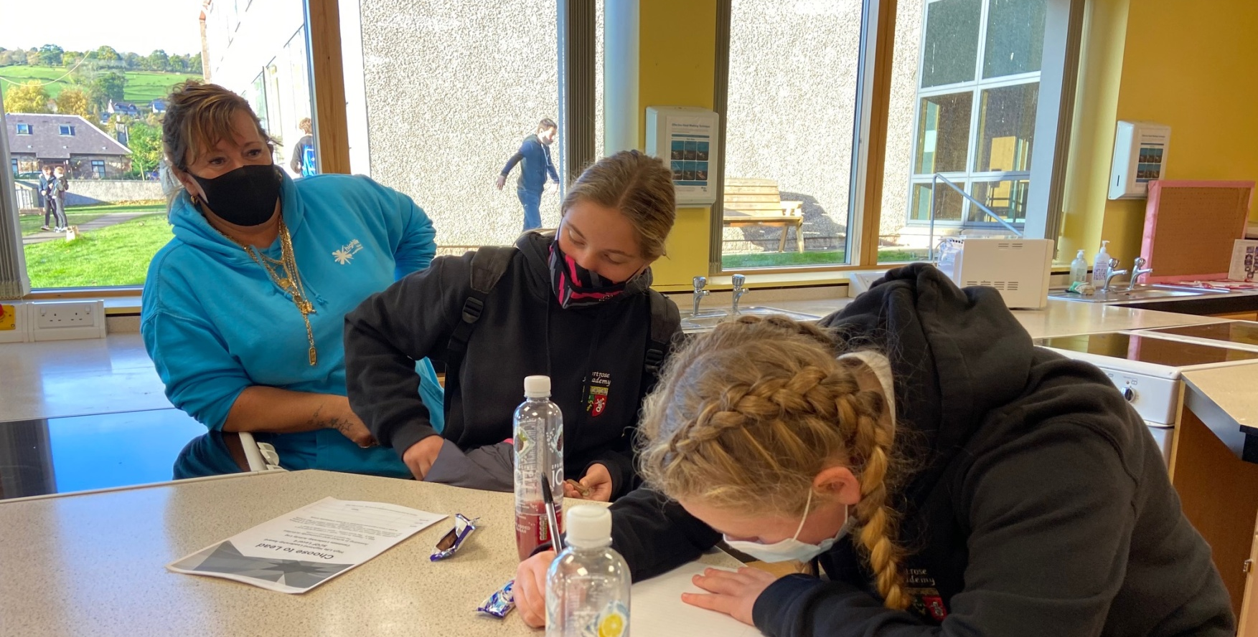
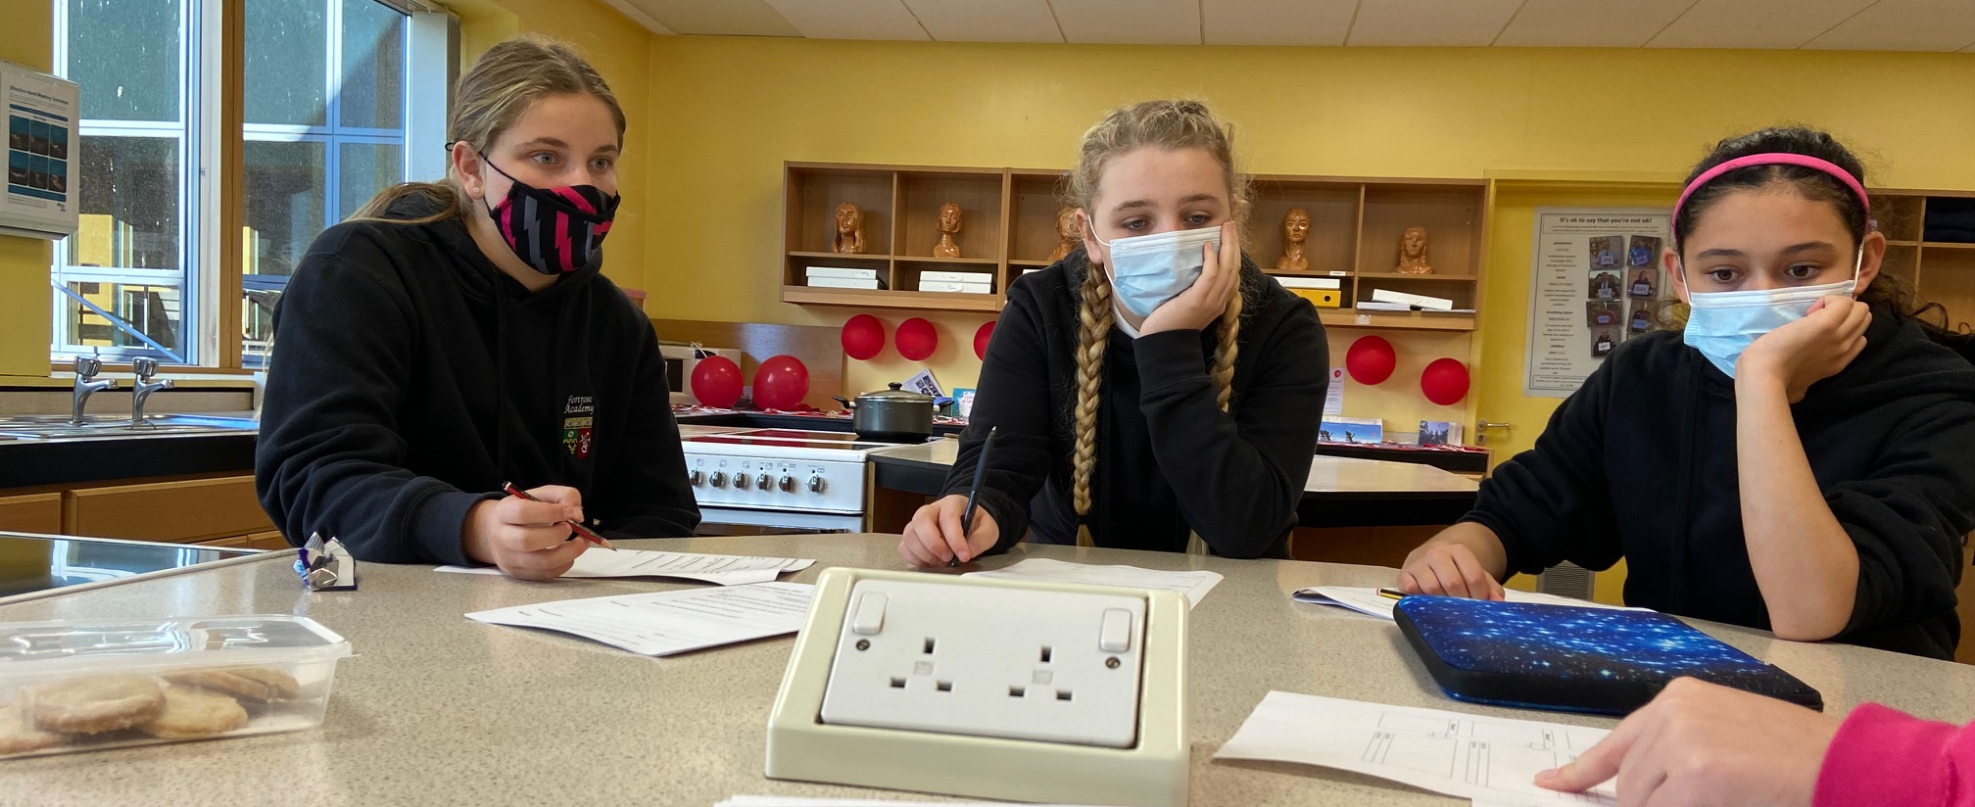
Wider Achievement
Young People are taking part in High Life Highland Choose to Lead Level 4 certificated course
Varoious different courses on the Virtual College
Various different courses on CALA E-Learning

Slide 14
Resilience In Your Community
Working with Bloom Scotland on their Resilience in Your Community Project – co delivered with Fraser & Liz Newstead from Support in Mind Scotland
6 participants each week
Each week young people are given scenarios to discuss and give their ideas how to overcome the barriers
So far we have covered:
What resilience means
Exam Stress and pressures
What is curiosity

Slide 15
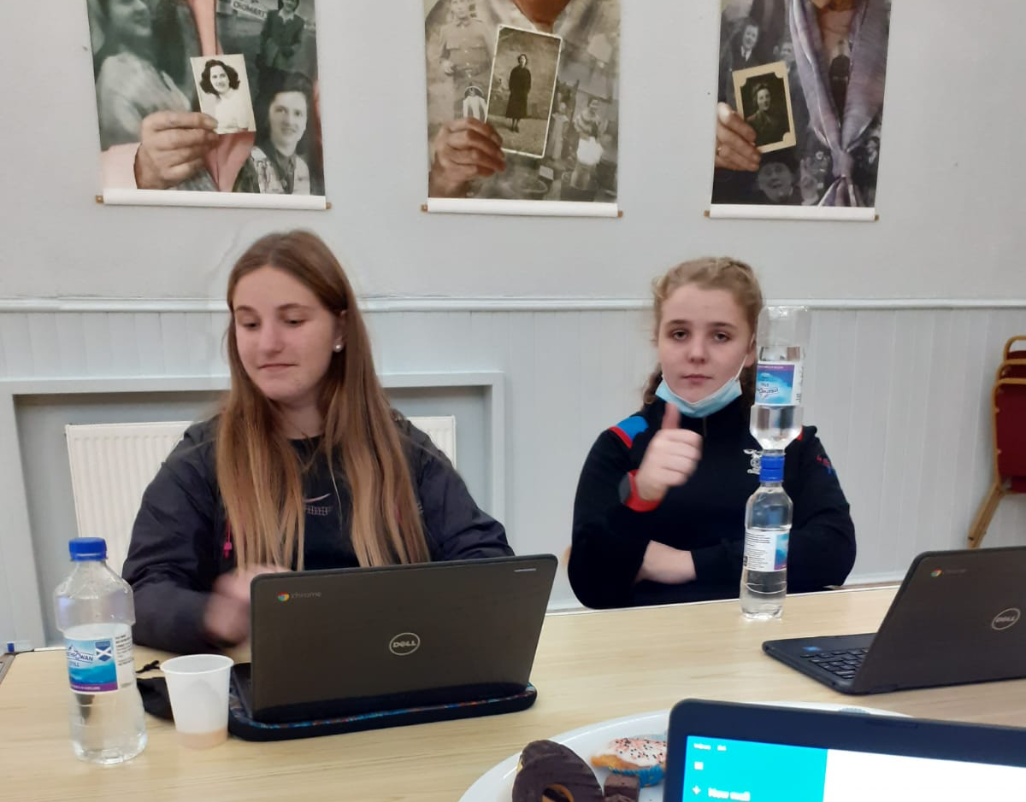
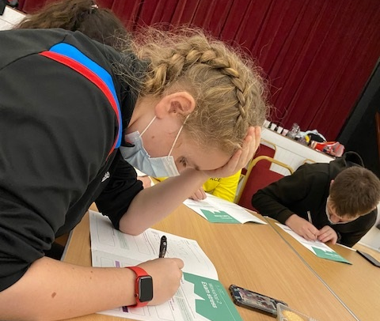
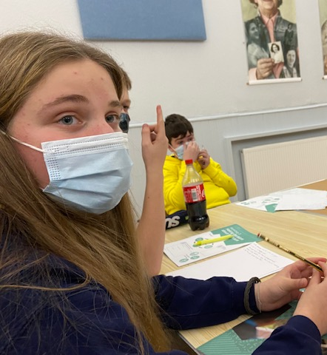
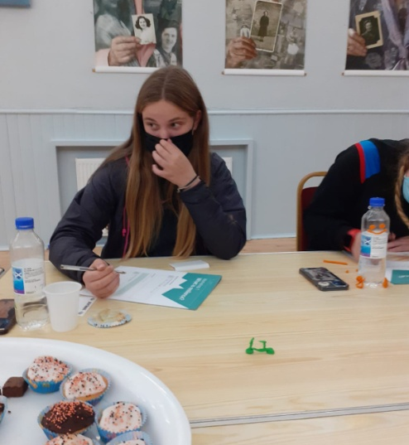

Slide 16
Staff Development
Conversation around intergenerational learning from an early year's perspective. Wanda & Fraser
Wanda and Fraser are working on their International Diploma in Intergenerational Learning with the University of Granada

Slide 17
Funding Biggest thank you to Wanda for doing these
Application done to the Black Isle Ward Discretionary Budget –for funding toward Football Coaching & Sports Equipment.
MFR Cash for Kids – 22 Mission Christmas Application Submitted – Approved Gifts to be collected.
Salvation Army for ALDI Voucher to shopping for a Christmas Meal – x 4 (in previous years we have been given hampers but due to COVID, it is now a voucher.)
FareShare – Wanda did an application to FareShare for donations of food to be used at Cookwell / Bakewell classes

Slide 18
Meeting’s
Meeting
Meeting about the Adult and Youth meeting Community Learning Development plan
Planning
Planning meetings weekly for the Resilience in Your Community Project.
Highlife Highland Outdoor Education for Summer 2022
Active Schools about Choose to Lead Course
Mikey’s line Sessions
Fortrose Academy Equality & Diversity Group and Steering Group

Slide 19
Saltire & Leadership Awards
Young people support with the delivery of Cromarty Youth Café’s Multi-Sports Class on a Monday night – the young people plan , do & Review the sessions,
In the review part we have conversations about what worked and what didn’t work so well and what could be changed for the following week.
Supporting young people to update their Saltire and Leadership paperwork

Slide 20
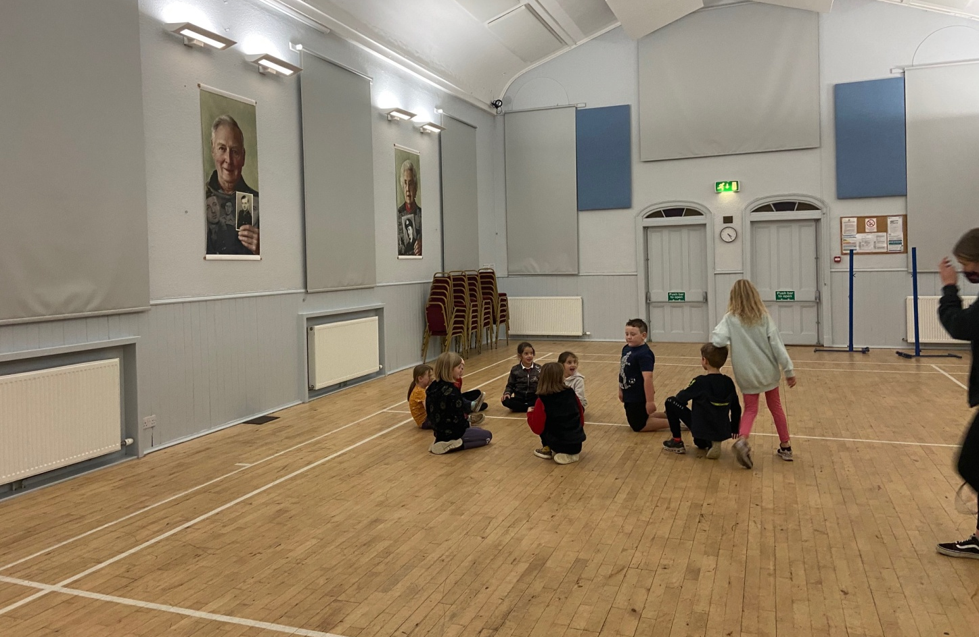
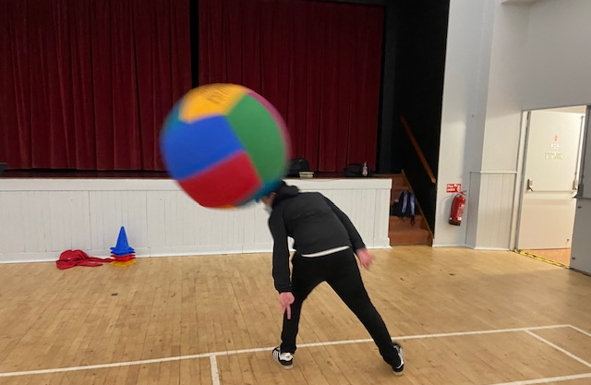
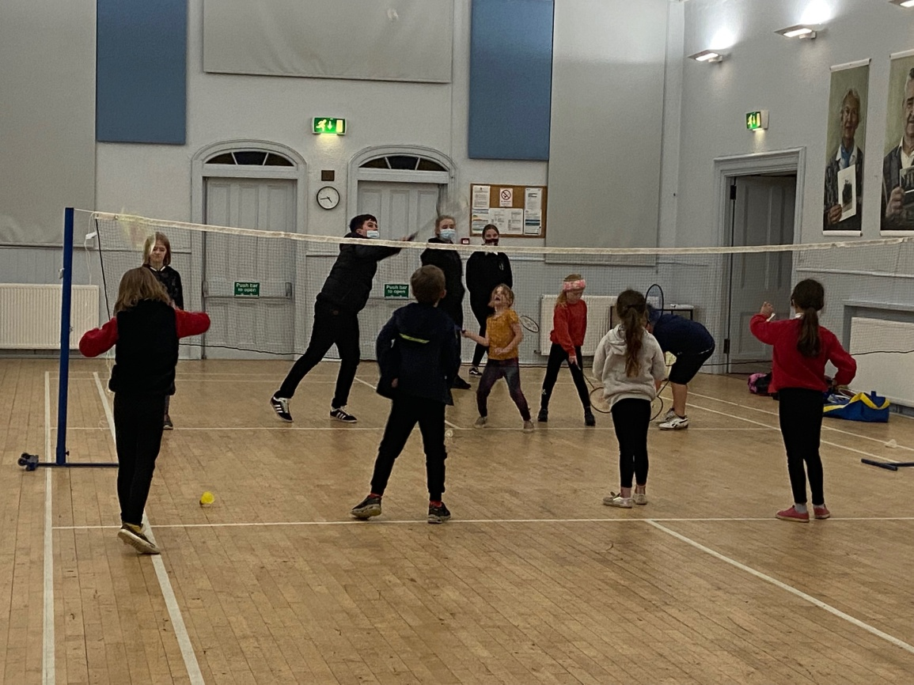
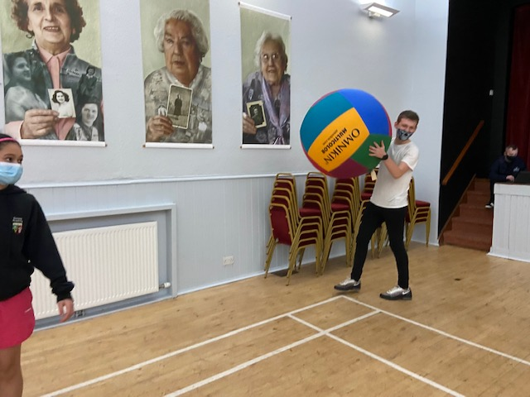
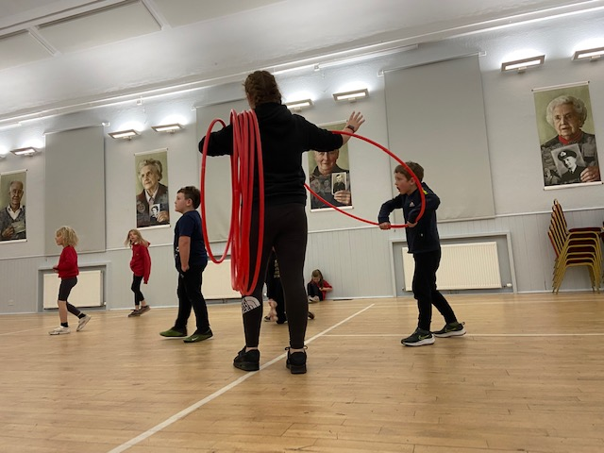

Slide 21
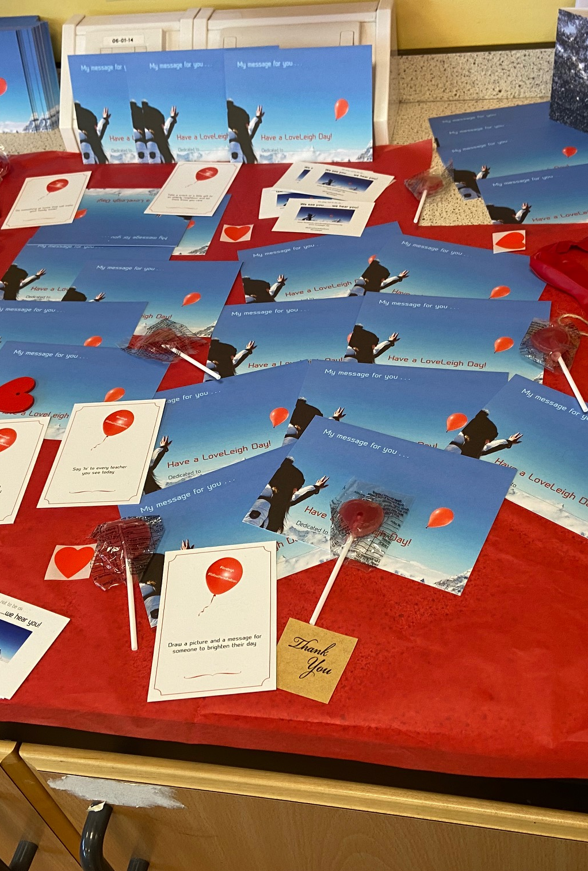
Loveleigh Project
In Partnership with the Wellbeing on The Black Isle Group we are going to be working on the LoveLeigh project
As a member of our Wellbeing on the Black Isle working group, we are requesting that you help us make November a little bit brighter for everyone. It’s a long, dark month, and our group would like to share an idea with you to help make it brighter!
During the month of November we encourage you to support this project and help to reduce the stigma around mental health. What will this involve? We would like to encourage people to carry out random acts of kindness – simply to make the school and community a kinder, warmer place.
Here is the link to the Loveleigh website https://loveleigh.net/ which will give you more information about the project, as well as some resources.
So, please continue to be kind to each other – always – and a special wee effort in November #followtheredballoon.
What we have done:
Virtual Hugs have been given to Shore Mills Care Home, and CYC Leaders
Residents in Cromarty have been given home baking

Slide 22
Partnership Development
Partners we work with:
Tesco Community Champions
Morrisons Community Champion
Fortrose Academy
Cromarty Primary School
MFR Cash For Kids
Active Schools Coordinators

Slide 23
Participation Forums
Over the last month Young people have attended these meeting:
Cromarty & District Community Council x 2 Youth Reps attending pre meeting to discus items to be brought up at the main meeting
Cromarty Community Rowing Club x 2 snr youth reps & x3 reps in training
Highland Youth Parliament x2 Youth Reps
Northern Alliance x 1 Youth Rep

Slide 24
Indoor Rowing
Indoor rowing with Tilly & Teagan.
The purpose of indoor rowing is to:
Improve Techniques
Increase Confidence and Self-Esteem
Helps to Reduce Anxiety
Helps build cardio & endurance
Helps compliment with outdoor rowing. Due to outdoor rowing being cancelled due to weather, so young people are still able to row.

Slide 25
